Slide 1
Fitness Concepts
Health-Related Fitness
Skill-Related Fitness
Training Principles

Slide 2
Lesson Goals
I can identify the 5 Health-Related Fitness Components
I can identify the 6 Skill-Related Fitness Components
I can explain the fitness training principles

Slide 5
Overload Principle

Slide 6
Overload Principle-
Increased demands are made upon the body by modifying the Frequency, Intensity, Time, Type (FITT)

Slide 7
Progression Principle

Slide 8
Progression Principle
Gradual increase in exercise or activity over a period of time

Slide 9
Specificity Principle

Slide 10
Specificity Principle-
Improvements in various fitness areas require specific kinds of activity

Slide 11
Regularity Principle

Slide 12
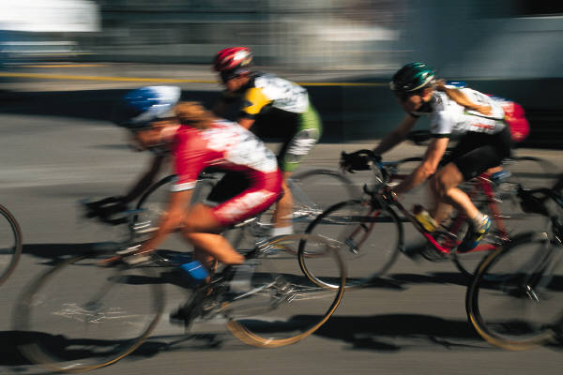
Regularity Principle
-
Based on the old adage “Use it or lose it!”
exercise on a regular basis

Slide 13
Individuality

Slide 14
Individuality-
Your exercise program must be based on your individual goals and objectives

Slide 16
Frequency

Slide 17
Frequency
Number of days you work out each week.
3-5 days per week
5-6 days per week for middle school athletes

Slide 18
Intensity

Slide 19
Intensity
Describes how hard a person exercises
60-85% of maximum heart rate
2-5 on OMNI Scale
Notes:
Add to discussion:
Generally a target hr is between 120-180 bpm
OMNI scale is an example of a RPE
Explain how to use the “Talk Test” to determine exercise intensity

Slide 20
OMNI Scale
Notes:
RPE rate of perceived exertion

Slide 21
Time

Slide 22
Time
How long the activity should be performed.
30-60 minutes daily
20 minutes or more in a single session

Slide 23
Type

Slide 24
Type
What kind of activity a person chooses to perform
A complete fitness plan will include a variety of activities

Slide 25
Health-Related Fitness
Cardiorespiratory fitness
Muscular Strength
Muscular Endurance
Flexibility
Body Composition

Slide 26
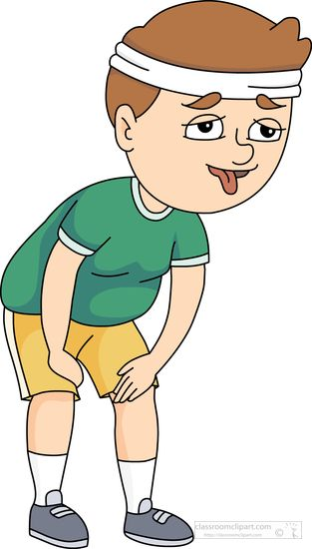
Cardiorespiratory Fitness
Ability to do vigorous, large muscle exercise over a long period of time
Notes:
Pacer test

Slide 27
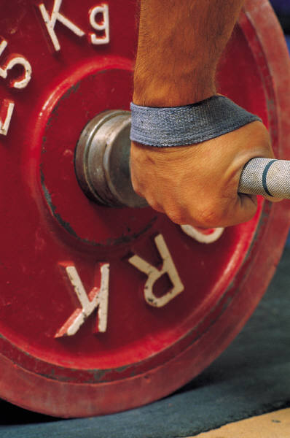
Muscular Strength
Amount of force that can be exerted by a single contraction of the muscle.
Notes:
Trunk lift
Pull-ups
Push-ups

Slide 28
Muscular Endurance
Ability to continue using certain muscles for a period time.
Notes:
Push-ups
Curl-ups

Slide 29
Flexibility
Ability of a joint and a muscle group to move through a range of motion.
Notes:
Sit and reach
Trunk lift

Slide 30
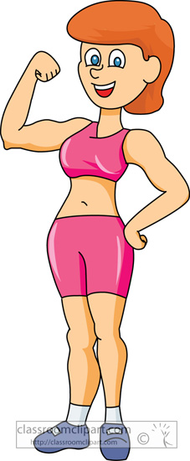
Body Composition
Percent of body weight composed of fat compared to the percent that is composed of tissue, bone and muscle.
Notes:
BMI-body mass index

Slide 31
Skill-Related Fitness
Agility
Balance
Coordination
Power
Reaction Time
Speed

Slide 32
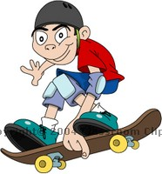
Agility
Ability to start, stop and move the body quickly and in different directions.

Slide 33
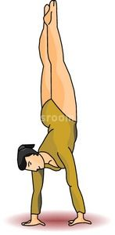
Balance
A kind of coordination which allows you to maintain control of your body while stationary or moving

Slide 34
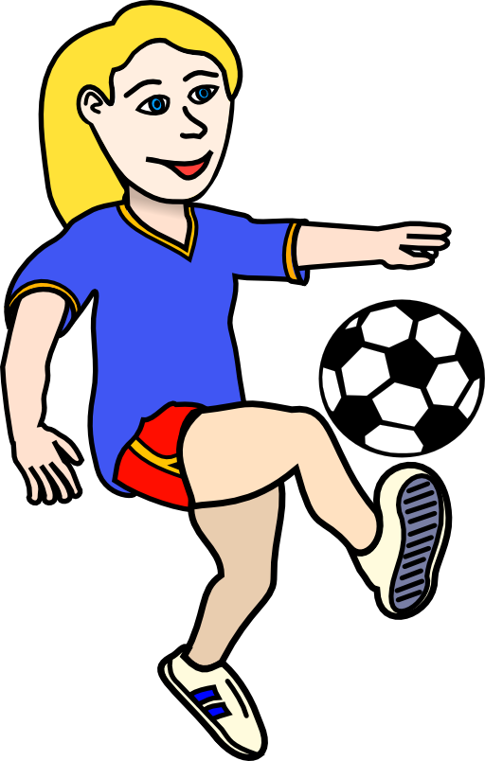
Coordination
Ability to do a task integrating movements of the body and different parts of the body

Slide 35
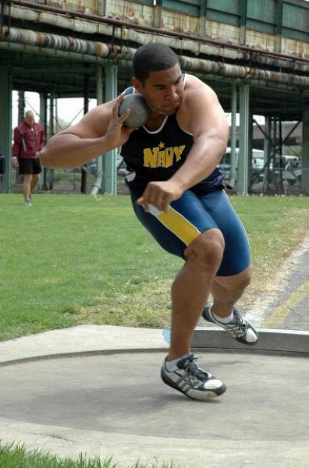
Power
Ability to combine strength and speed in a movement

Slide 36
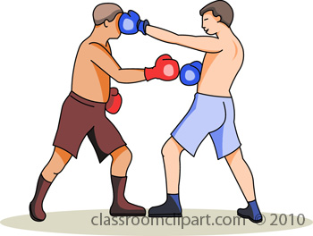
Reaction Time
Time required to start a movement after being alerted to the need to move.

Slide 37
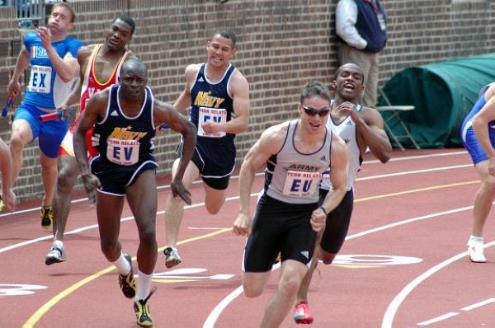
Speed
Abilility to move your body quickly from one point to another

